Slide 1
Caption Generator
Guide Name: Dr. S Thenmozhi Vijaykumar R Pai
Associate Professor, Dept. of CA PES1201702013
PES University

Slide 2
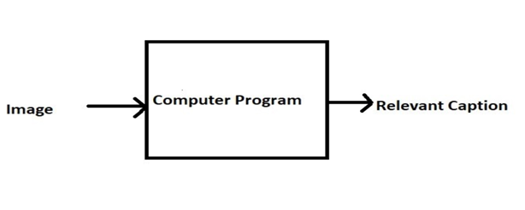

ABSTRACT
Caption Generator is a Machine Learning application which identifies the action portrayed in the given image.
The generated caption will describe about the image that will say what kind of actions is taking place in it.

Slide 3
INTRODUCTION
You saw an image and your brain can easily tell what the image is about, but can a computer tell what the image is representing?
With the advancement in Deep learning techniques and availability of huge datasets and computer power, it is possible to build models that can generate captions for an image.
This project involves Computer Vision and Natural Language Processing concepts to recognize the context of an image and describe them in a natural language like English.
The objective of the project is to build a working model of Caption Generator by implementing CNN with LSTM.
The basic working of the application is that the features are extracted from the images using pre-trained VGG16 model and then fed to the LSTM model along with the captions to train.
The trained model is then capable of generating captions for any images that are fed to it.

Slide 4
LITERATURE SURVEY
Existing Systems
Captionbot.ai
It is a product of Microsoft.
It is an ML application which can understand the content of any image.
When a person upload a photo, it is sent to Microsoft for image analysis to return a caption
The application will not store or publish the images anywhere.
It uses Computer Vision API and Emotion API
How-Old.net
It is also a product of Microsoft.
It estimates the age of the person in the given image.
The age is generated as a caption
TwinsOrNot.net
It identifies whether the image has twins or not

Slide 5

LITERATURE SURVEY
Research Papers
Title: Automatic Description Generation from Images: A Survey of Models, Datasets, and Evaluation Measures
Authors: Raffaella Bernardi, Ruket Cakici, Desmond Elliott, Aykut Erdem, Erkut Erdem, Nazli Ikizler-Cinbis, Frank Keller, Adrian Muscat, Barbara Plank
Publication: Journal of Artificial Intelligence Research submitted on 15th Jan 2016 - https://arxiv.org/abs/1601.03896
Summary: Here in this paper, the authors have described their project as a challenging problem as the model was not working properly with natural images that have recently received a huge amount of attraction from the computer vision and natural language processing communities. Also, they have classified the existing approaches based on how they conceptualized this problem. They have helped in reviewing the detailed description of existing models along with their advantages and disadvantages.

Slide 6
Title: An Empirical Study of Language CNN for Image Captioning
Authors: Jiuxiang Gu, Gang Wang, Jianfei Cai, Tsuhan Chen
Publication: 2017 IEEE International Conference on Computer Vision - https://ieeexplore.ieee.org/abstract/document/8237400/authors#authors
Summary: In this paper, the effectiveness of their approach is validated on two datasets: Flickr30K and MS COCO. The extensive experimental results show that their method outperforms the vanilla recurrent neural network-based language models and is competitive with state-of-the-art methods.
Even with 30000 images, the author was able to get only 76 % accuracy.

Slide 7
Title: A Comprehensive survey of Deep Learning for Image Captioning
Authors: MD. Zakir Hossain, Ferdous Sohel, Mohd Fairuz Shiratuddin, Hamid Laga
Publication: Journal on Deep Learning for Image Captioning submitted on 14th October 2018 - https://arxiv.org/pdf/1810.04020.pdf
Summary: In this paper, Although deep learning-based image captioning methods have achieved remarkable progress in recent years, a robust image captioning method that is able to generate high-quality captions for all images is yet to be achieved.

Slide 8
Title: What is the Role of Recurrent Neural Networks (RNNs) in an Image Caption Generator?
Authors: Marc Tanti, Albert Gatt, Kenneth P. Camilleri
Publication: Journal on Computer Vision and Pattern Recognition submitted on 7th August 2017 - https://arxiv.org/abs/1708.02043
Summary: In this paper, a recurrent neural network (RNN) is typically viewed as the primary ‘generation’ component. The authors suggest that the image features should be ‘injected’ into the RNN. They have viewed the RNN algorithm as only encoding the previously generated words. According to the authors, the RNN algorithm should only be used to encode linguistic features and that only the final representation should be ‘merged’ with the image features at a later stage. The paper compares these two architectures. As suggested RNNs are better viewed as encoders, rather than generators.

Slide 9
TOOLS AND TECHNOLOGIES
Frontend: HTML, CSS, Bootstrap
Backend: Flask 1.x
Development Tool: Python 3.7
Storage (Dataset): Google Drive
IDE: Jupyter Notebook (Anaconda 3), VS Code
Packages: TensorFlow, Keras

Slide 10
Functionalities
User Perspective
The User launches the application.
User uploads the images for which the captions are to be generated.
User clicks on the submit button.
Within a matter of seconds, the ML model recognizes and process the content of an image.
The result will be displayed on the page.

Slide 11
Functionalities
Model Development and Deployment
Data Gathering
Images for training the model
Corpus for Image captions
Pre-processing
Corpus – Removal of stop words, punctuation marks, digits
Generating the bag of words
Mapping of images with the Corpus
Feature extraction from images
Object identification
Model Generation using CNN
Building LSTM (Long Short Term Memory) model.
Validating the Model
Deploy the ML model in the web application

Slide 12
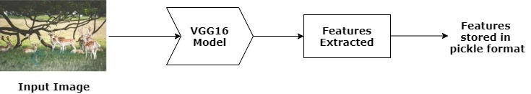
DETAILED METHODOLOGY
How Images are Pre-Processed
CNN model could be used directly as part of a broader image caption model. The problem is, it is a large model and running each photo through the network every time we want to test a new language model configuration is redundant. Instead, we can pre-compute the “photo features” using the pre-trained model and save them to file. We can load these features later and feed them into our model as the interpretation of a given photo in the dataset. It is no different to running the photo through the full VGG model.
This is an optimization that will make training our models faster and consume less memory.
Once features are extracted, they are stored in pickle format as a file for future use.

Slide 13
DETAILED METHODOLOGY
2. How Captions are Pre-Processed
The dataset contains multiple descriptions for each photograph and the text of the descriptions requires some minimal cleaning. Once the file containing all of the descriptions of the images, the objective is to find the unique identifier of each image. This identifier is used on the photo filename and in the text file of descriptions.
Once the list of photo descriptions are loaded, it will return a dictionary of photo identifiers to descriptions. Each photo identifier maps to a list of one or more textual descriptions. Then the descriptions are needed to be cleaned. Then the cleaned descriptions are tokenized so that they are easier to work with.
The text is cleansed in order to reduce the size of the vocabulary of words. It is done to convert all words to lowercase, remove all punctuations, remove all words that are one character or less in length and remove all words with numbers in them. Once cleaned, we can summarize the size of the vocabulary.
Ideally, a small and expressive vocabulary is expected.
Finally, the dictionary of image identifiers and descriptions are saved to a new file called descriptions.txt with one image identifier and description per line.

Slide 14
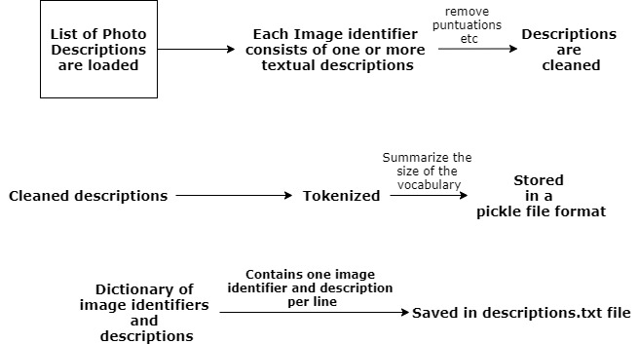
DETAILED METHODOLOGY

Slide 15
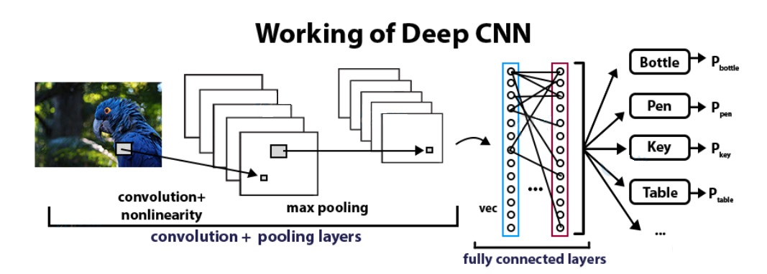
DETAILED METHODOLOGY
3. Convolutional Neural Networks
CNN Algorithm – With the help of CNN Algorithm, features are extracted from the images with the help of pre-trained VGG16 model.
CNN Algorithm is being used in this project as they are specialized deep neural networks which can process the data that has input shape like a 2D matrix. Images are easily represented as a 2D matrix and CNN is very useful in working with images.

Slide 16
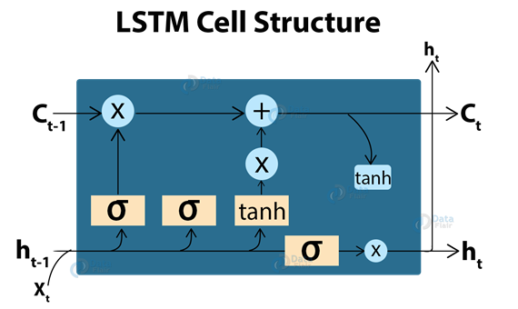
DETAILED METHODOLOGY
4. LSTM (Long Short Term Memory)
LSTM Algorithm – With the features being extracted from the images with the help of CNN Algorithm, they are now fed into the LSTM model which will be responsible for generating the image captions.
LSTM (Long Short Term Memory) is a type of RNN which is well suited for sequence prediction problems. With the help of LSTM, it can predict what the next word will be. LSTM will use the information from CNN to help generate a description of the image.

Slide 17
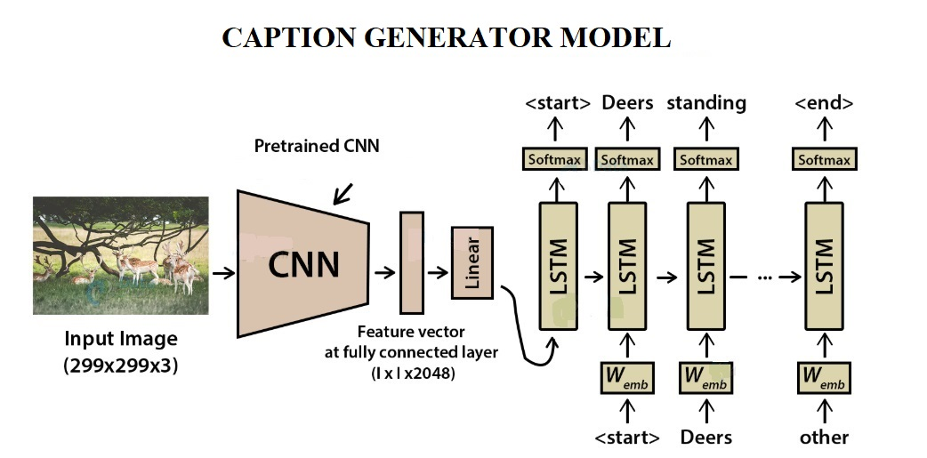
5. Model Generation

Slide 18
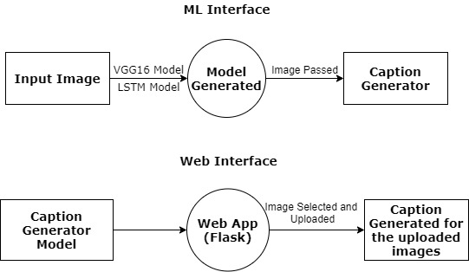
Design diagrams
DFD

Slide 19
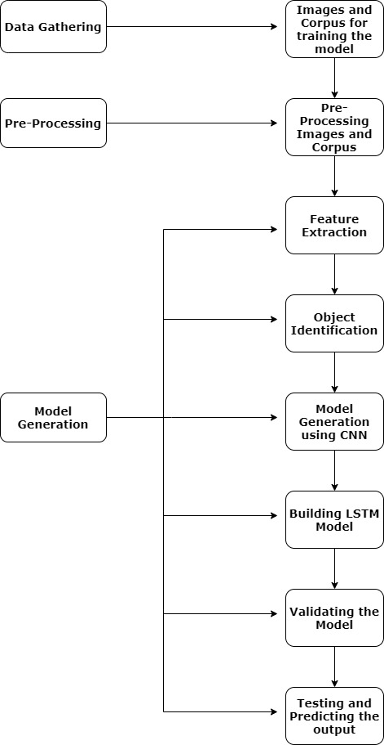
Process Flow Diagram

Slide 20
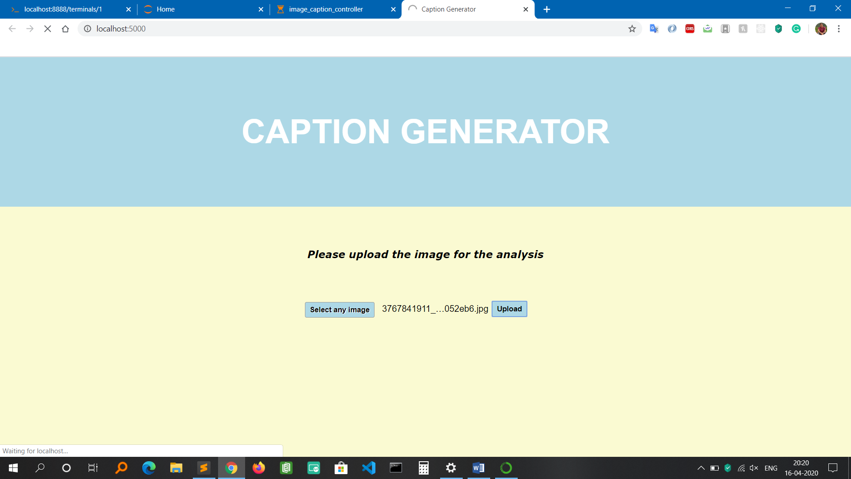
IMPLEMENTATION
HOME screen

Slide 21
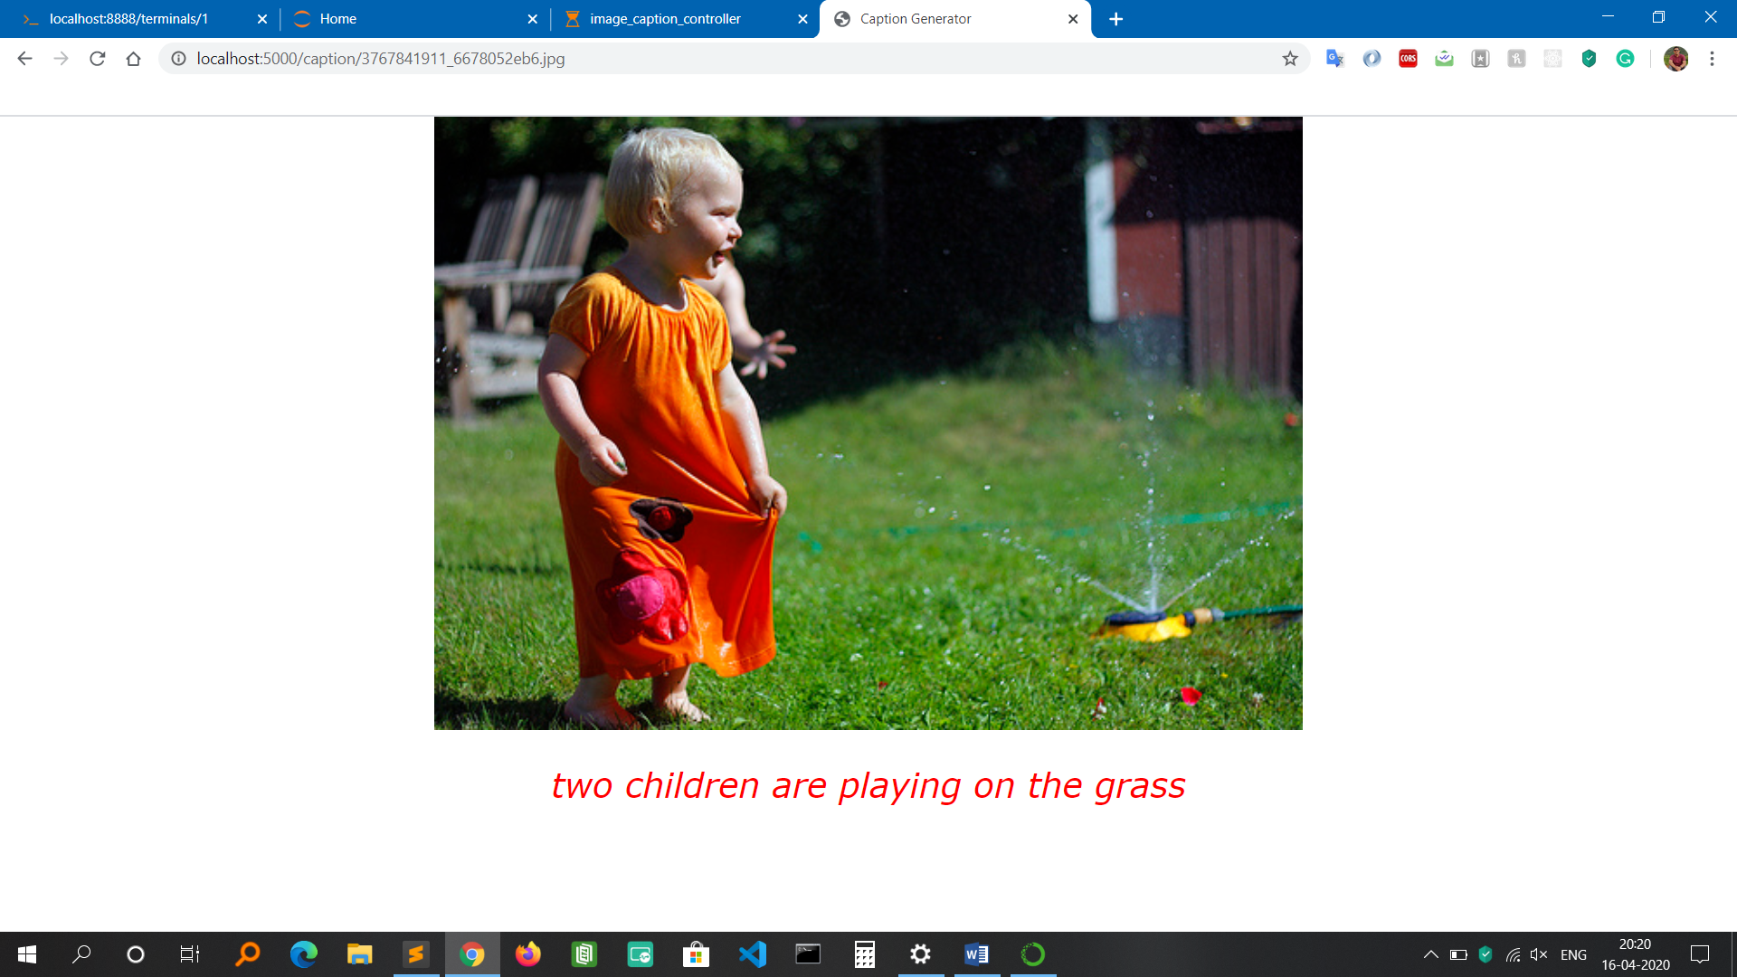
RESULT page

Slide 22
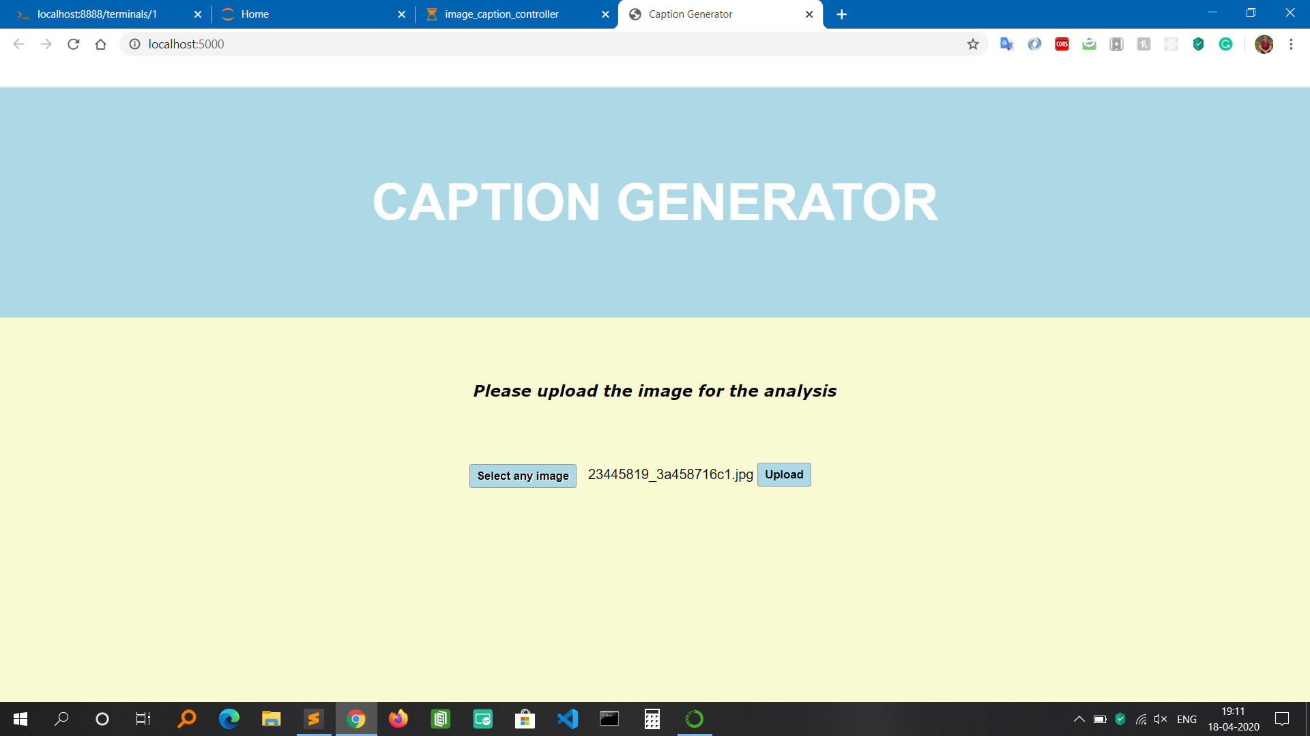

Slide 23
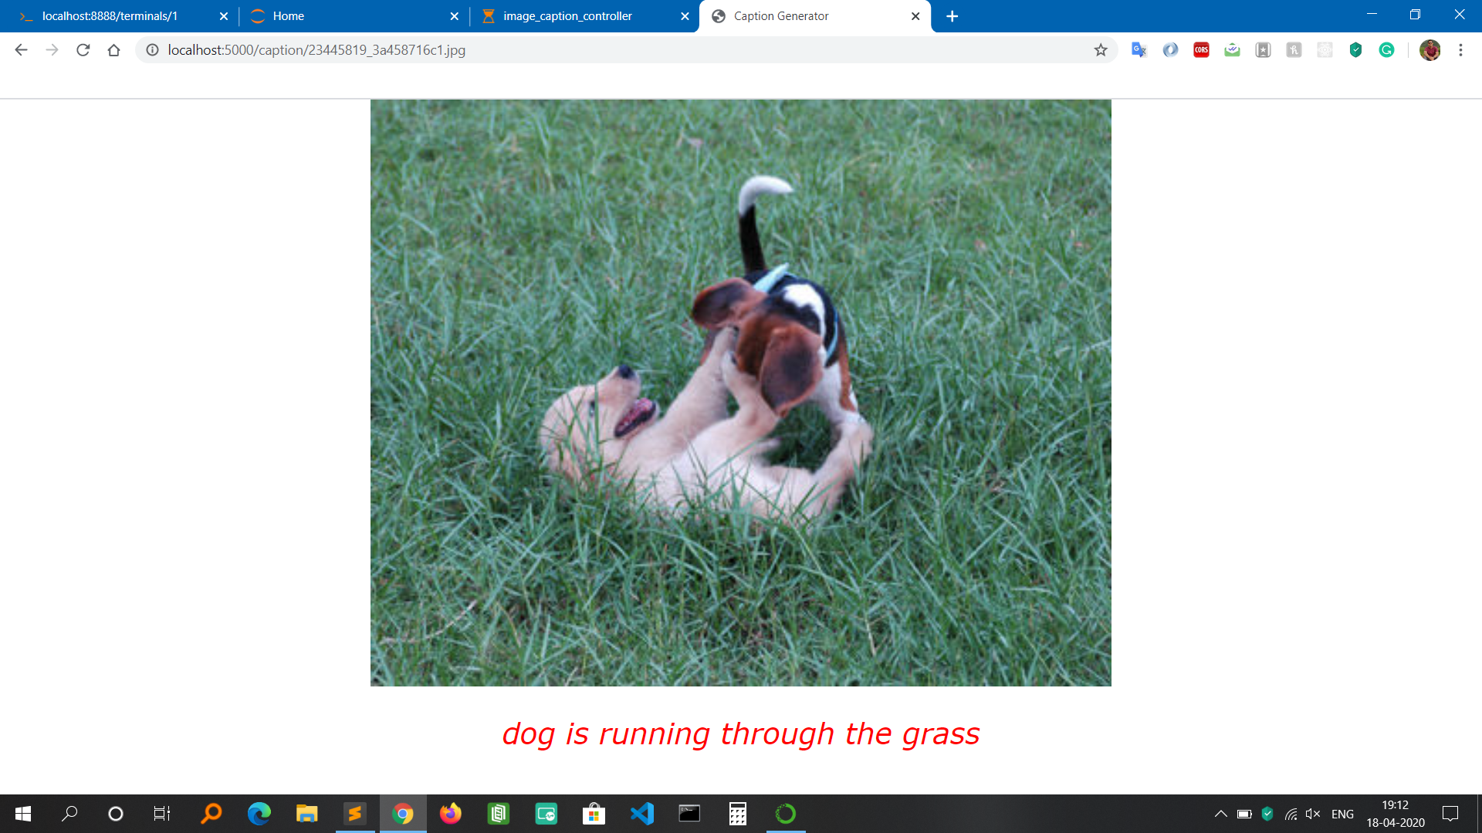

Slide 24


Slide 25
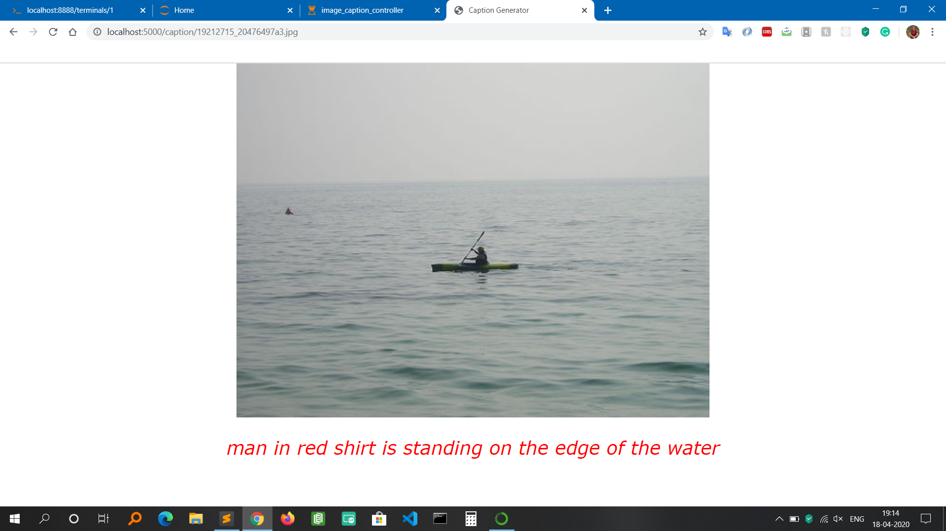

Slide 26
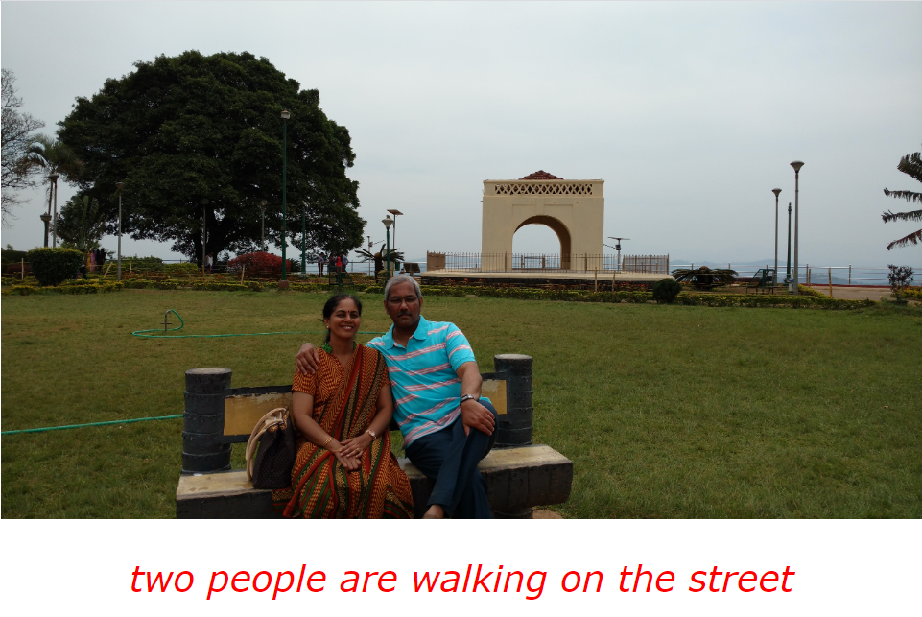
RESULT OF WRONG GENERATION OF CAPTION

Slide 27
TESTING
 | Test Case Description |  |  |  |  | Test the Functionality of uploading the image for analysis
 | Date of Testing |  |  |  |  | 16-April-2020 |  | Test Case Status |  | Pass
Serial no |  | Prerequisites: |  |  |  | Serial no | Test Data
1 |  | Access to Chrome Browser |  |  |  | 1 | Choose file = Upload images of any format like jpg, jpeg, png
Test Scenario |  | Verify on the ability to upload the images of any format for analysis after selecting the desired image
Step no |  | Step Details |  | Expected Results |  | Actual Results |  |  | Pass / Fail / Not executed / Suspended
1 |  | Navigate to http://localhost:5000/ |  | Caption generator homepage should open |  | Successfully redirected |  |  | Pass
2 |  | Click on Choose File to select the image for uploading |  | File Explorer should open for selecting the image |  | File Explorer Window successfully opened |  |  | Pass
3 |  | Select the desired image |  | Should display the name of the image selected on the home page of the application |  | The image name is being displayed on the home page of the application |  |  | Pass
4 |  | Click on Upload button to upload the image for analysis |  | ML processing should begin in the background and should redirect to the result page for displaying the caption with the respective image |  | Page redirected and caption generated for the uploaded image. |  |  | Pass

Slide 28
 | Test Case Description |  |  |  |  | Test the Functionality by trying to upload non-image file
 | Date of Testing |  |  |  |  | 16-April-2020 |  | Test Case Status |  | Fail
Serial no |  | Prerequisites: |  |  |  | Serial no | Test Data
1 |  | Access to Chrome Browser |  |  |  | 1 | Choose file = .txt
Test Scenario |  | Verify on the ability to upload non-image files like .txt
Step no |  | Step Details |  | Expected Results |  | Actual Results |  |  | Pass / Fail / Not executed / Suspended
1 |  | Navigate to http://localhost:5000/ |  | Caption generator homepage should open |  | Successfully redirected |  |  | Pass
2 |  | Click on Choose File to select non-image file like .txt |  | File Explorer should open for selecting the file |  | File Explorer Window successfully opened |  |  | Pass
3 |  | Select the txt file |  | Should display the name of the image selected on the home page of the application |  | The image name is being displayed on the home page of the application |  |  | Pass
4 |  | Click on Upload button to upload the image for analysis |  | Page should not redirect because the application accepts only jpg, jpeg and png format files. |  | Page not redirected |  |  | Fail

Slide 29
Test Case Description |  |  | Testing the functionality of prompting the user to upload image file format only.
Date of Testing |  |  | 16-April-2020 |  |  |  | Test Case Status |  |  |  | Fail
Serial no |  | Pre-requisites: |  |  |  |  |  |  |  | Serial no |  | Test Data
1 |  | Access to Chrome Browser |  |  |  |  |  |  |  | 1 |  | Choose file = .html
 |  |  |  |  |  |  |  |  |  | 2 |  | Click on the upload button
Test Scenario |  | Verify on whether user gets a prompt informing to upload only image file format
Step no |  | Step Details |  |  |  | Expected Results |  |  |  | Actual Results |  |  |  |  | Pass / Fail / Not executed / Suspended
1 |  | Navigate to http://localhost:5000/ |  |  |  | Caption generator homepage should open |  |  |  | Successfully redirected |  |  |  |  | Pass
2 |  | Click on Choose File to select non-image file like .html |  |  |  | File Explorer should open for selecting the file |  |  |  | File Explorer Window successfully opened |  |  |  |  | Pass
3 |  | Select any .html file |  |  |  | Should display the name of the file selected on the home page of the application |  |  |  | File name is displayed on the home page of the application |  |  |  |  | Pass
4 |  | Click on Upload button to upload the file for analysis |  |  |  | Application should not process the file and should prompt a message saying file type not allowed |  |  |  | No prompt message displayed |  |  |  |  | Fail

Slide 30
 | Test Case Description |  |  |  |  | Test the Functionality of uploading the image for analysis without selecting any image
 | Date of Testing |  |  |  |  | 16-April-2020 |  | Test Case Status |  | Pass
Serial no |  | Prerequisites: |  |  |  | Serial no | Test Data
1 |  | Access to Chrome Browser |  |  |  | 1 | Click the upload button
Test Scenario |  | Verify on whether the home page gets redirected to result page without selecting any image
Step no |  | Step Details |  | Expected Results |  | Actual Results |  |  | Pass / Fail / Not executed / Suspended
1 |  | Navigate to http://localhost:5000/ |  | Caption generator homepage should open |  | Successfully redirected |  |  | Pass
2 |  | Click on Upload button to upload the image for analysis |  | The Validator should display a message saying ‘Please select a file’ as no image is selected for uploading |  | Page not redirected and Validator displays a message saying ‘Please select a file’ |  |  | Pass

Slide 31
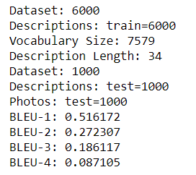
Bleu score FOR MODEL EVALUATION
BLEU-1: corpus_bleu(actual, predicted, weights=(1.0, 0, 0, 0)
BLEU-2: corpus_bleu(actual, predicted, weights=(0.5, 0.5, 0, 0)
BLEU-3: corpus_bleu(actual, predicted, weights=(0.3, 0.3, 0.3, 0)
BLEU-4: corpus_bleu(actual, predicted, weights=(0.25, 0.25, 0.25, 0.25)

Slide 32
Bleu score interpretation
Bilingual Evaluation Understudy (BLEU) is a score for comparing a candidate translation of the text to one or more reference translations. It is a metric for evaluating a generated sentence to a reference sentence. If the score is 50 % and above, it is a very good score.
The BLEU score calculations in NLTK allow you to specify the weighting of different n-grams in the calculation of the BLEU score.
Helps in the ability to calculate different types of BLEU score, such as individual and cumulative n-gram scores.
An individual N-gram score is an evaluation of just matching grams of a specific order, such as single words (1-gram) or word pairs (2-gram or bigram).
Eg: reference = [['this', 'is', 'a', 'test']]
candidate = ['this', 'is', 'a', 'test']
sentence_bleu(reference, candidate, weights=(1, 0, 0, 0)
sentence_bleu(reference, candidate, weights=(0, 1, 0, 0)
sentence_bleu(reference, candidate, weights=(0, 0, 1, 0)
sentence_bleu(reference, candidate, weights=(0, 0, 0, 1)

Slide 33
CONCLUSION
The objective of the project was to identify the action portrayed in the given image. The generated caption will describe the image that will say what kind of actions is taking place in it.
This has been solved with my application as it provides a service to users that helps in generating captions for any images of their choice once they upload it in my application.
Besides, the whole application has been saved in the GitHub repository. So in the future, if the user requests for any changes, it can be easily done through git version control.

Slide 34
FUTURE ENHANCEMENT
Distorted and blurred images can also be considered.
Caption Generation should work for video also.
A Mobile Application can be developed that will make the user more convenient to use.
In the future, some hybrid algorithms can be used to achieve a higher accuracy that will help in better generation of captions for the images.

Slide 35
BIBLIOGRAPHY
Jason Brownlee (2007), Deep Learning for Natural Language, Edition v1.1
Raffaella Bernardi, Ruket Cakici, Desmond Elliott, Aykut Erdem, Erkut Erdem, Nazli Ikizler-Cinbis, Frank Keller, Adrian Muscat, Barbara Plank, Automatic Description Generation from Images: A Survey of Models, Datasets, and Evaluation Measures, Retrieved from journal of Artificial Intelligence Research submitted on 15th Jan 2016 - https://arxiv.org/abs/1601.03896
Jiuxiang Gu, Gang Wang, Jianfei Cai, Tsuhan Chen, An Empirical Study of Language CNN for Image Captioning, Retrieved from 2017 IEEE International Conference on Computer Vision - https://ieeexplore.ieee.org/
MD. Zakir Hossain, Ferdous Sohel, Mohd Fairuz Shiratuddin, Hamid Laga, A Comprehensive survey of Deep Learning for Image Captioning, Retrieved from journal on Deep Learning for Image Captioning submitted on 14th October 2018 - https://arxiv.org/pdf/1810.04020.pdf
Kenneth P. Camilleri Marc Tanti, Albert Gatt, What is the Role of Recurrent Neural Networks (RNNs) in an Image Caption Generator?, Retrieved from Journal on Computer Vision and Pattern Recognition submitted on 7th August 2017 - https://arxiv.org/abs/1708.02043
Flickr8k Dataset - https://www.kaggle.com/flickr8k
Sumit Saha - A Comprehensive Guide to Convolutional Neural Networks – the ELI5 way - https://towardsdatascience.com/a-comprehensive-guide-to-convolutional-neural-networks-the-eli5-way-3bd2b1164a53
Rohit Thakur - Step by step VGG16 implementation in Keras for beginners - https://towardsdatascience.com/step-by-step-vgg16-implementation-in-keras-for-beginners-a833c686ae6c
Jason Brownee – Deep Learning for Natural Language Processing - https://machinelearningmastery.com/deep-learning-for-nlp/
Shuang Bai – A survey on automatic image caption generation - https://www.sciencedirect.com/science/article/abs/pii/S0925231218306659?via%3Dihub#!
Anonymous (2018) – VGG16 – Convolutional Network for Classification and Detection - https://neurohive.io/en/popular-networks/vgg16/

Slide 36
THANK YOU

